Slide 1

Customer retention case study
E-retail factors for customer activation and retention: A case study from Indian e-commerce customers

Slide 2

Content
Customer satisfaction has emerged as one of the most important factors that guarantee the success of online store; it has been posited as a key stimulant of purchase, repurchase intentions and customer loyalty. A comprehensive review of the literature, theories and models have been carried out to propose the models for customer activation and customer retention. Five major factors that contributed to the success of an e-commerce store have been identified as: service quality, system quality, information quality, trust and net benefit. The research furthermore investigated the factors that influence the online customers repeat purchase intention. The combination of both utilitarian value and hedonistic values are needed to affect the repeat purchase intention (loyalty) positively. The data is collected from the Indian online shoppers. Results indicate the e-retail success factors, which are very much critical for customer satisfactio

Slide 3
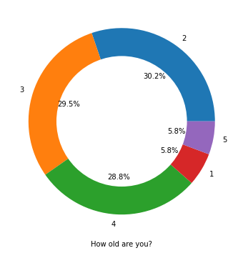
PI-Chart

Slide 4
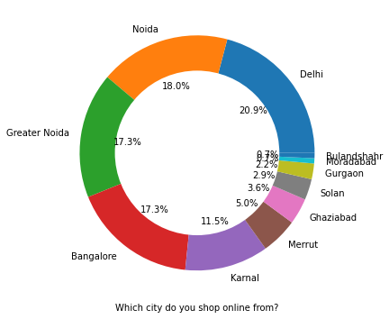
Cities you shop online:

Slide 5
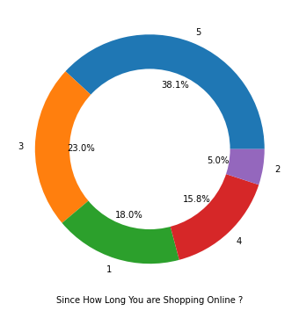
Since how long you are shopping

Slide 6
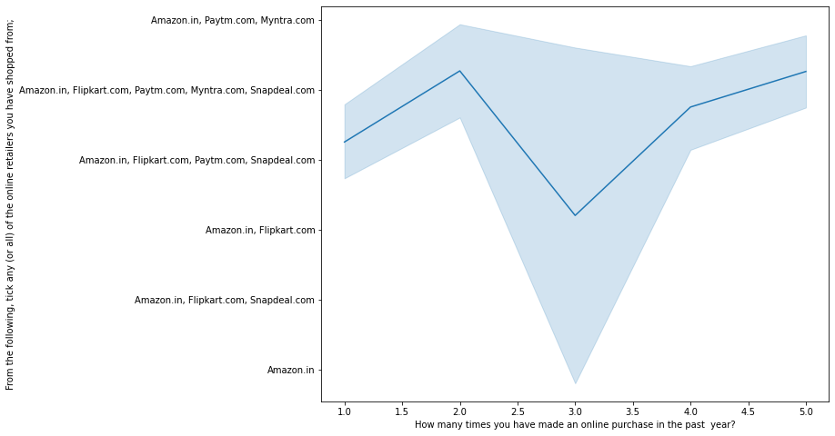
Analysis on the basis of Various following factors

Slide 7
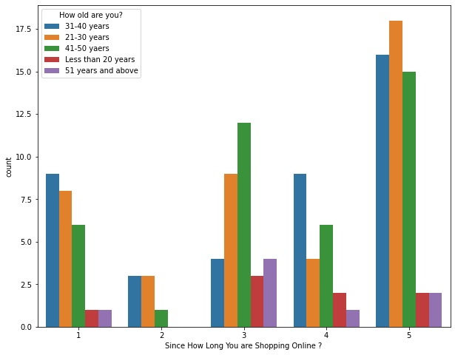
Online Retailing:

Slide 8
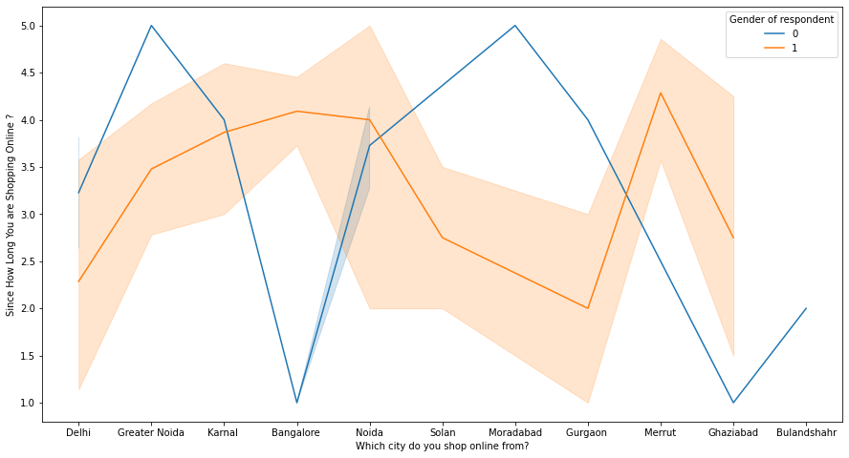
Shopping from different places:

Slide 9
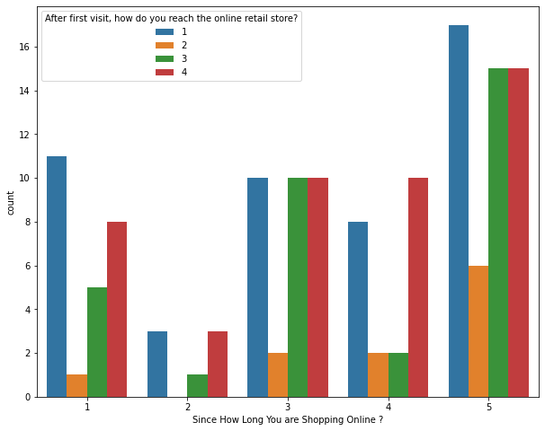
After first visit, how do you reach the online retail store?:

Slide 10
Conclusion:
All the websites were not equally preferred by online customers. Amazon was the most preferred followed by Flipkart. This can be explained easily by previous result that we got. These two companies are most trusted in the industry and hence, have a huge reliability. Also, the sellers listed on these websites are generally from Tier 1 cities as compared to Snapdeal and PayTM which have more sellers from tier 2 and 3 cities. Also, these websites have the most lenient return policies as compared to others and also the time required to process a return is low for these.
The reliability of the E-commerce company is also important, as it is even required in offline retail. It is important because customers are paying online, so they need to be sure of security of the online transaction. The return policies are important because in online retail customer does not get to feel the product. Thus, he wants to be sure that it will be possible to return the product if he does not like it in real. Whereas, the logistics factor, which included Cash on delivery option, One day delivery and the quality of packaging plays a secondary role in this process though these are Must-be-quality. This is so because these all does not interfere with the real product and people believe that this is the basic value that E-commerce websites provide

Slide 11
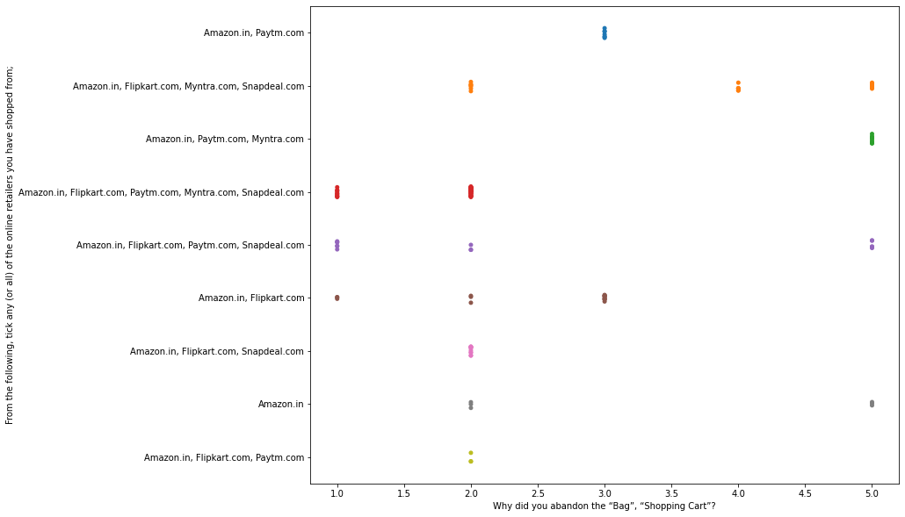
From the following, tick any (or all) of the online retailers you have shopped from:

Slide 12

Thank you!

